Slide 1
ANALOG ELECTRONIC CIRCUITS COURSE PROJECT QUADRATURE DOWN OSCILLATOR

Slide 2
THE APPLICATION OF THE QUADRATURE DOWN CONVERTER
Down converters are used to down convert high frequency RF signals to a lower Intermediate frequency(IF).
An I/Q down converter consists of two mixers: one for the I component and another for the Q component.
The I mixer multiplies the RF signal by a local oscillator signal with a phase shift of 0 degrees.(In phase component)
The Q mixer multiplies the RF signal by a local oscillator signal but with a phase shift of 90 degrees. (quadrature component)
By using quadrature down conversion, we create two versions of the down converted signal with a phase difference of 90 degrees which is used in doing the down conversion process.

Slide 3
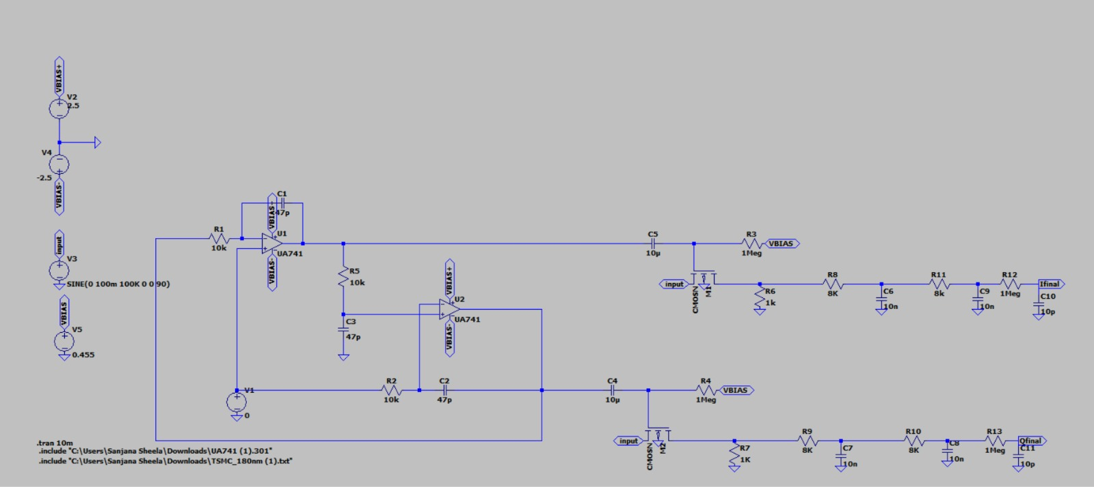
LT SPICE SIMULATION
CIRCUIT DIAGRAM

Slide 4
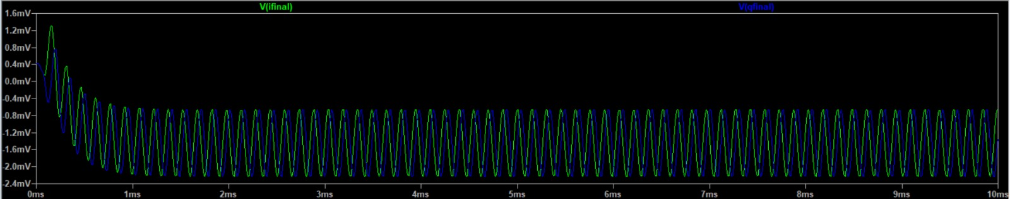
FINAL OUTPUT
The high frequency signal (100K) is down converted to a low frequency signal (2K)

Slide 5
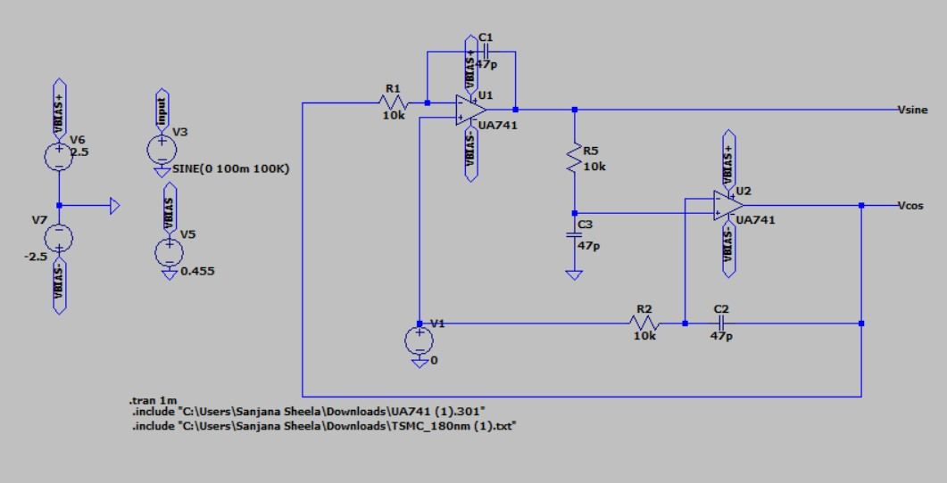
QUADRATURE OSCILLATOR
CIRCUIT DIAGRAM

Slide 6
WORKING OF THE OSCILLATOR
Initially there is no output but due to the positive feedback and the non-ideal behavior of the op-amps there is a slight perturbation.
The sine output from the inverting integrator is fed as input into the non-inverting integrator.
Sine wave will get integrated into cosine and the cosine will get integrated into sine.
To make the loop gain 1 as we don’t want amplification in every cycle because of which the output might saturate at a particular level R₁C₁ = R₂C₂ = R₃C₃

Slide 7
Calculation of the fosc
V₊₂ = (1/C₃S) / (R₂ + 1/C₃S) V_{SIN}
= 1/(1+R₃C₃S) V_{SIN}
From the voltage divider circuit of R₃C₃
V_{COS} = ((1 + R₂C₂S)/ R₂C₂S) * V₊₂
From the gain equation of the non-inverting amplifier
V_{SIN} = ( -1/R₁C₁S) * V_{COS}
From the gain equation of the inverting amplifier
The loop gain should be 1 so that there will be no problems with the saturation of the output.
Loop gain = 1 = 1/(1+R₃C₃S)* ((1 + R₂C₂S)/ R₂C₂S)* ( -1/R₁C₁S)
R1C1 = R2C2 = R3C3 substituting this in the above loop gain equation we get
(-1/RCS )(1/RCS) = 1 = (wRC) =(2*pi*fosc *RC)
Fosc= 1 /2*pi*RC

Slide 8
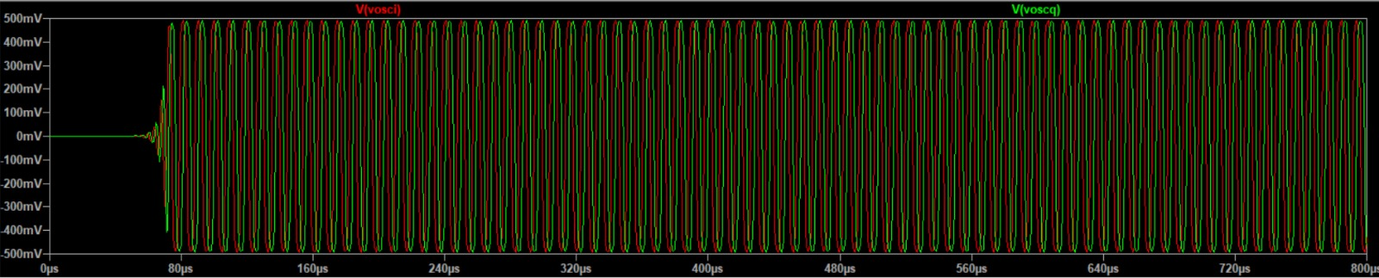
Output of Quadrature Oscillator

Slide 9
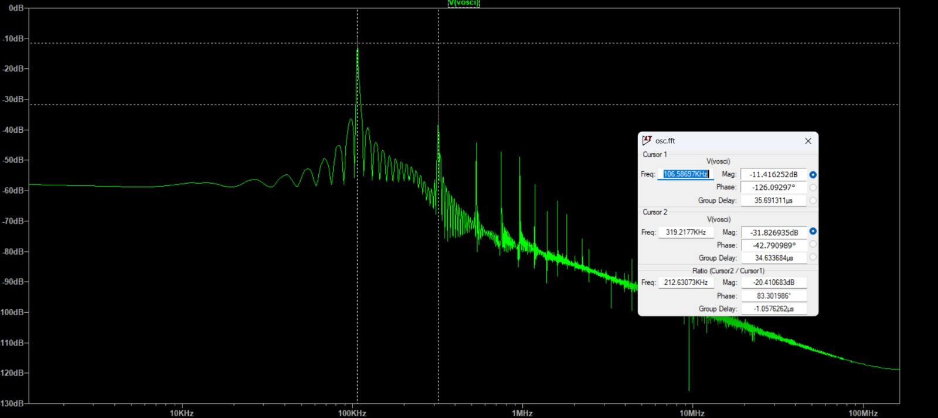
FFT OF SINE OUTPUT OF OSCILLATOR

Slide 10
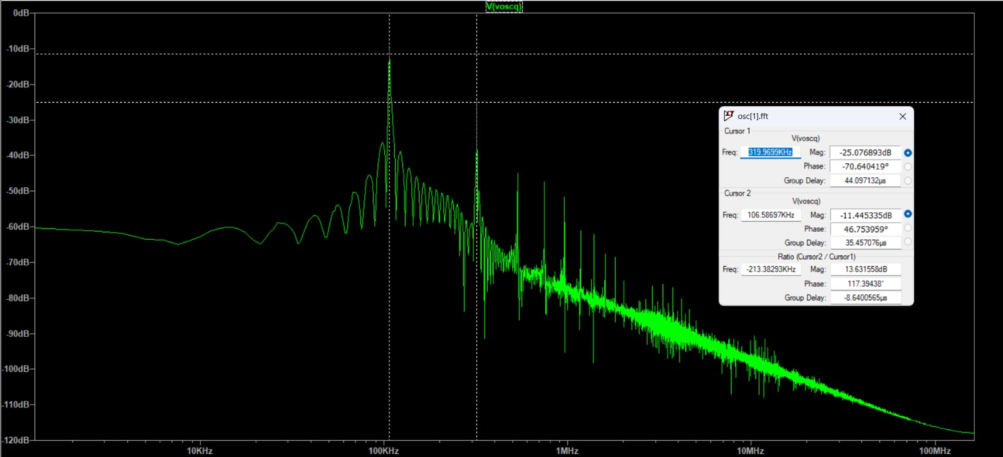
FFT OF COS OUTPUT OF OSCILLATOR

Slide 11
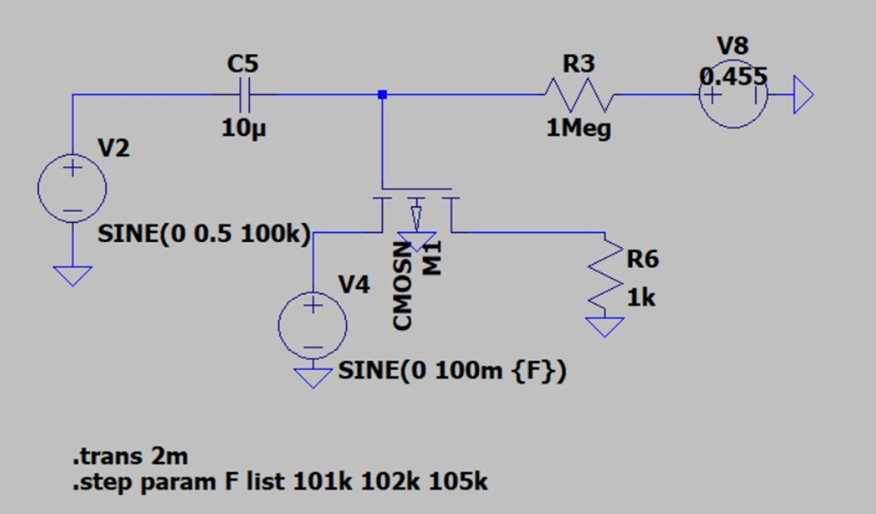
MIXER(SWITCH)
CIRCUIT DIAGRAM

Slide 12
WORKING OF A MIXER (SWITCH)
The mixer in this circuit is biased in such a way that it will always be in linear mode. In order to do this we make the Vbias value equal to threshold voltage for Vgs>Vth condition to satisfy.
The current in linear mode Id = µ_{n}C_{OX}(W/L) (V_{GS} -V_{T}) VDS
V_{GS =} V_{OSC} + V_{TH -} V_{IN}
V_{DS} = V_{OUT –} V_{IN}
I_{D =} µ_{n}C_{OX}(W/L) (V_{OSC} + V_{TH -} V_{IN} -V_{TH}) (V_{OUT -} V_{IN})
V_{OSC} >> VIN ignoring the value of the vin wrt vosc
I_{D =} µ_{n}C_{OX}(W/L) (V_{OSC} ) (V_{OUT -} V_{IN})
In order to get the output as the multiplication of the V_{IN} and the V_{OSC ,} V_{OUT} << V_{IN}
I_{D =} µ_{n}C_{OX}(W/L) (V_{OSC} ) ( ₋ V_{IN}) so the current flows in reverse direction that means source and drain in the mosfet are exchanged.
V_{switchoutput} = I_{D}* R_{L =} µ_{n}C_{OX}(W/L) (V_{OSC} ) ( ₋ V_{IN}) R_{L}

Slide 13
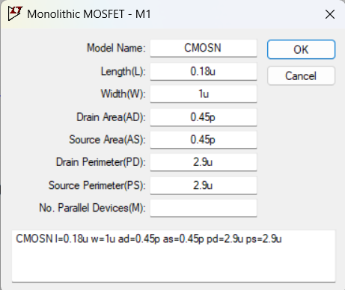
Mixer Parameters
MOSFET PARAMETERS
The value of R_{BIAS} = 1M ohm
This value is very high because
The value of C_{c} = 10 uF

Slide 14
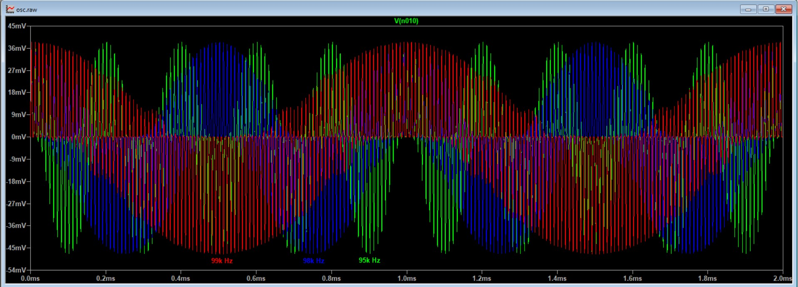
Transient Plots for varying V_{IF}
For f_{IN} = 95kHz, 98kHz, 99kHz

Slide 15
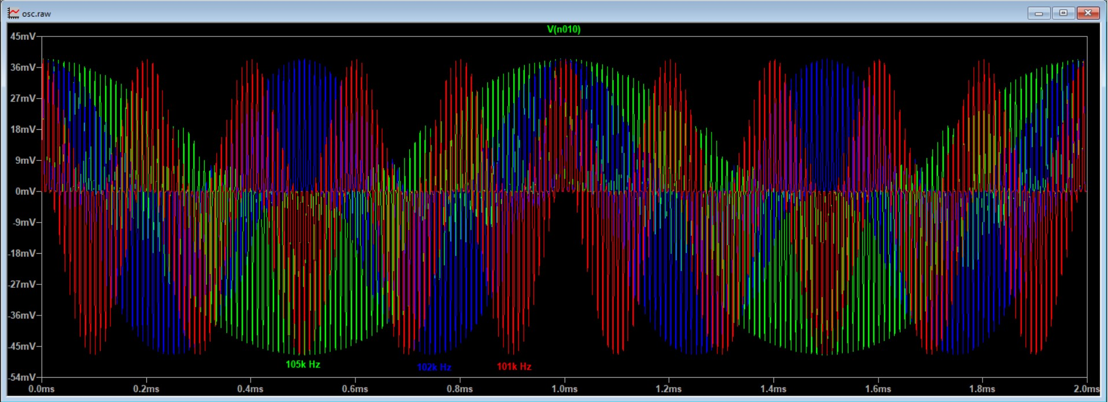
For f_{IN} = 101kHz, 102kHz, 105kHz

Slide 16
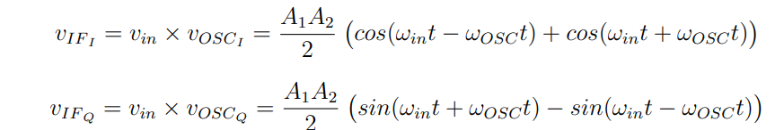
Mathematical form of the output of the mixer
So according to this formula there are two signals : one with a low frequency and on with high. When we pass the signal through a low pass circuit the high frequency component is getting attenuated and the the low frequency signal is outputted. That’s the reason why the output frequency of the QDC is less compared to the input.

Slide 17
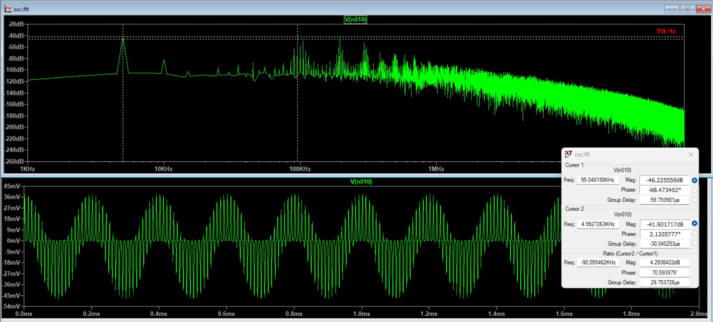
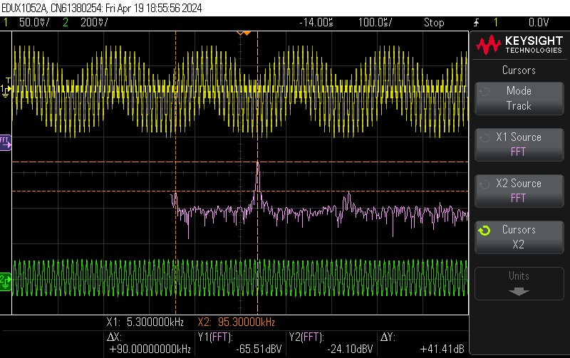
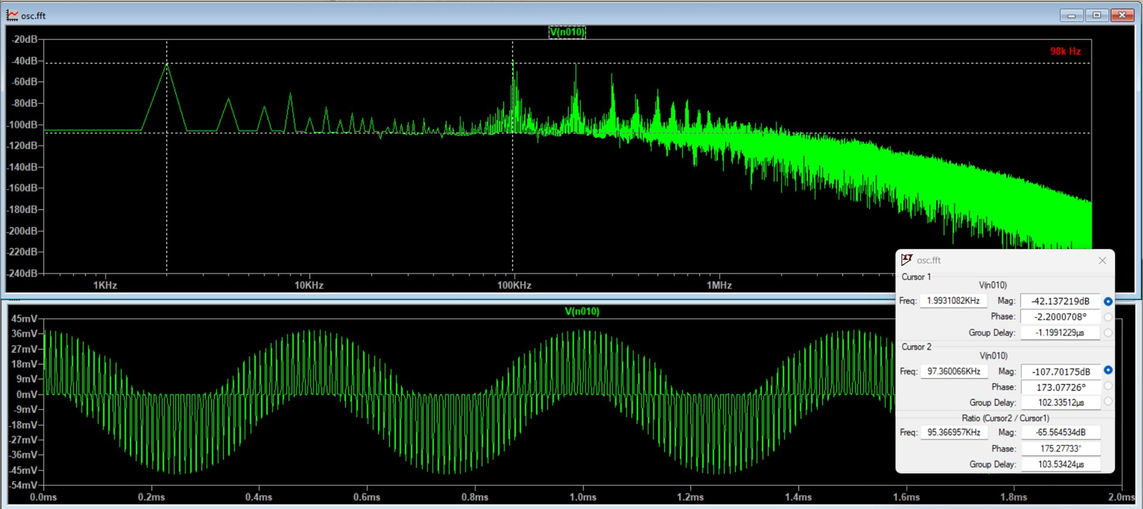
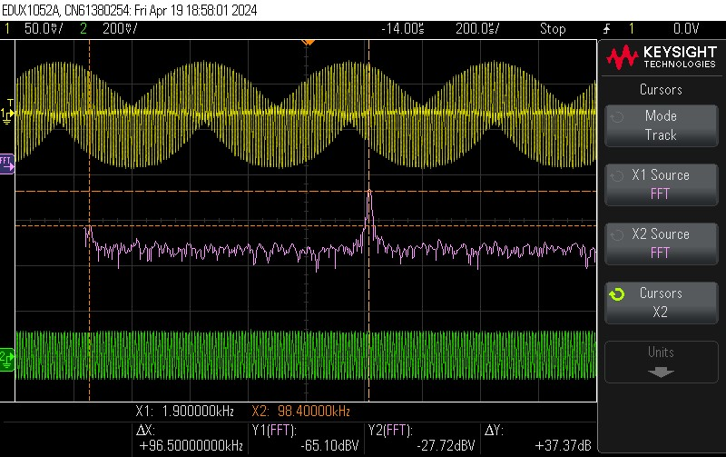
Sine wave
Transient and FFT Plot for f_{IN} = 95kHz
Transient and FFT Plots for fin = 98kHz

Slide 18
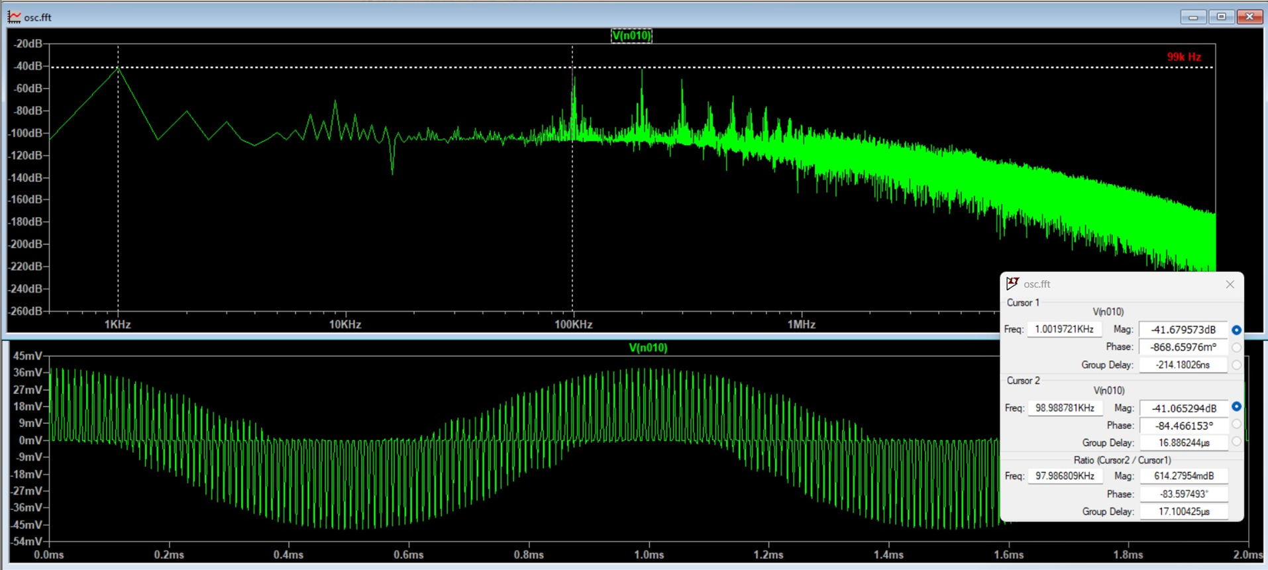
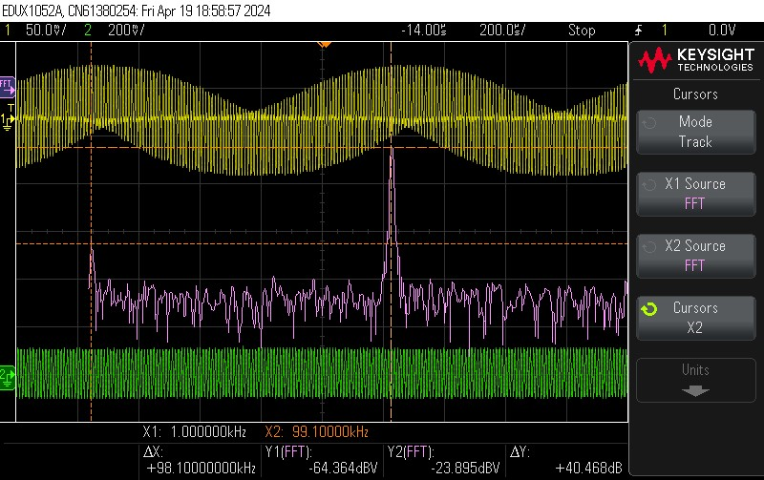
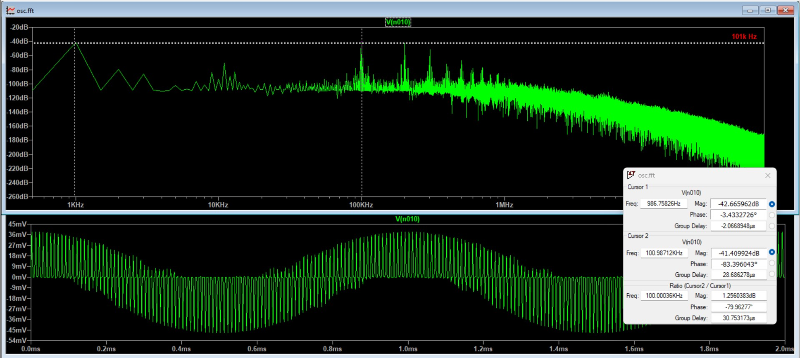
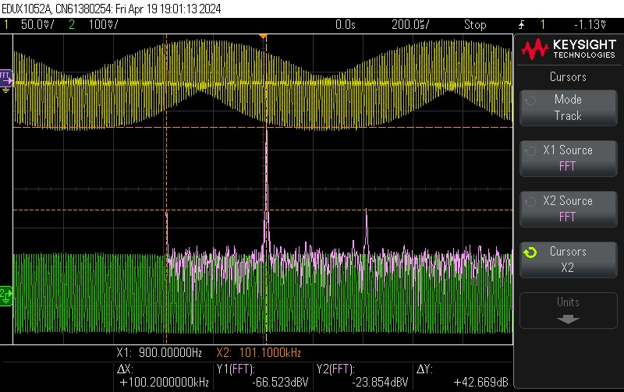
Transient And FFT Plots for f_{IN} = 99kHz
Transient And FFT Plots for f_{IN} = 101kHz

Slide 19
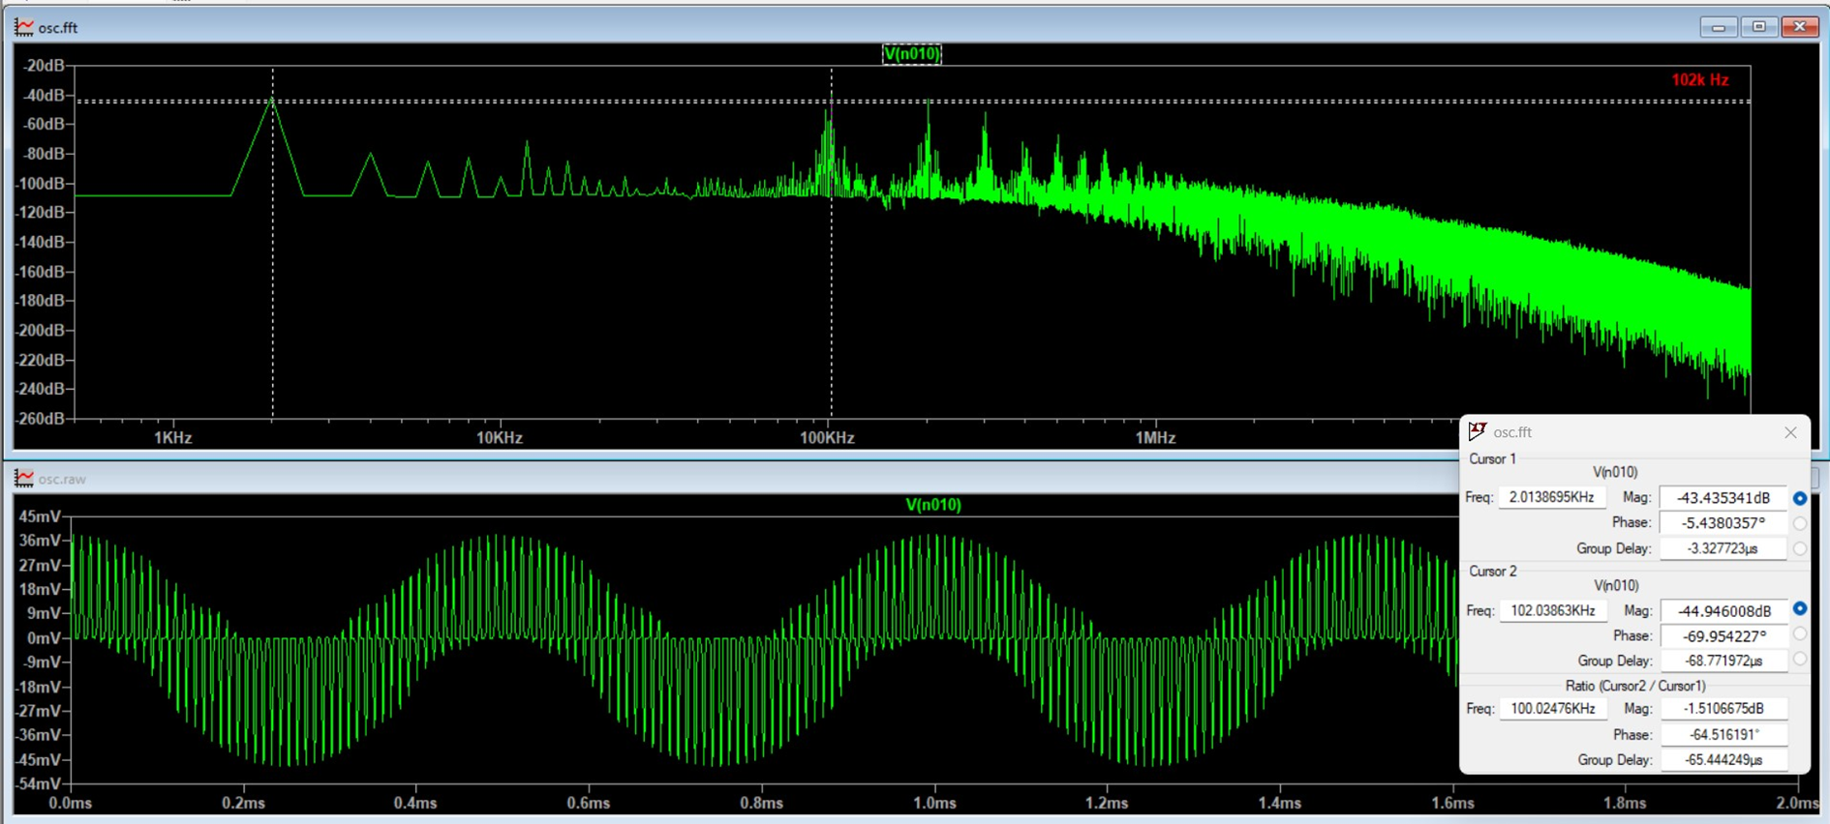
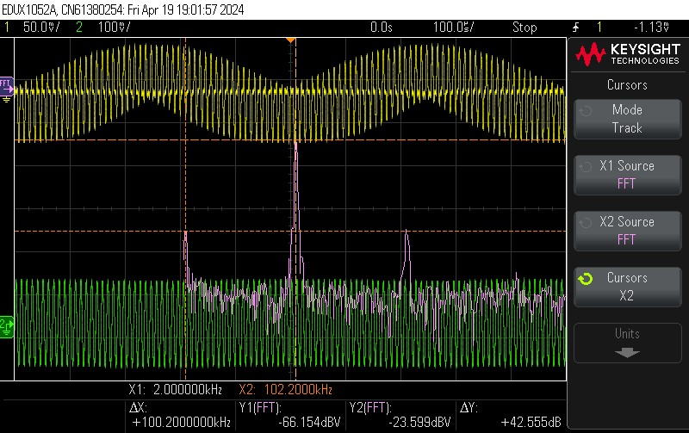
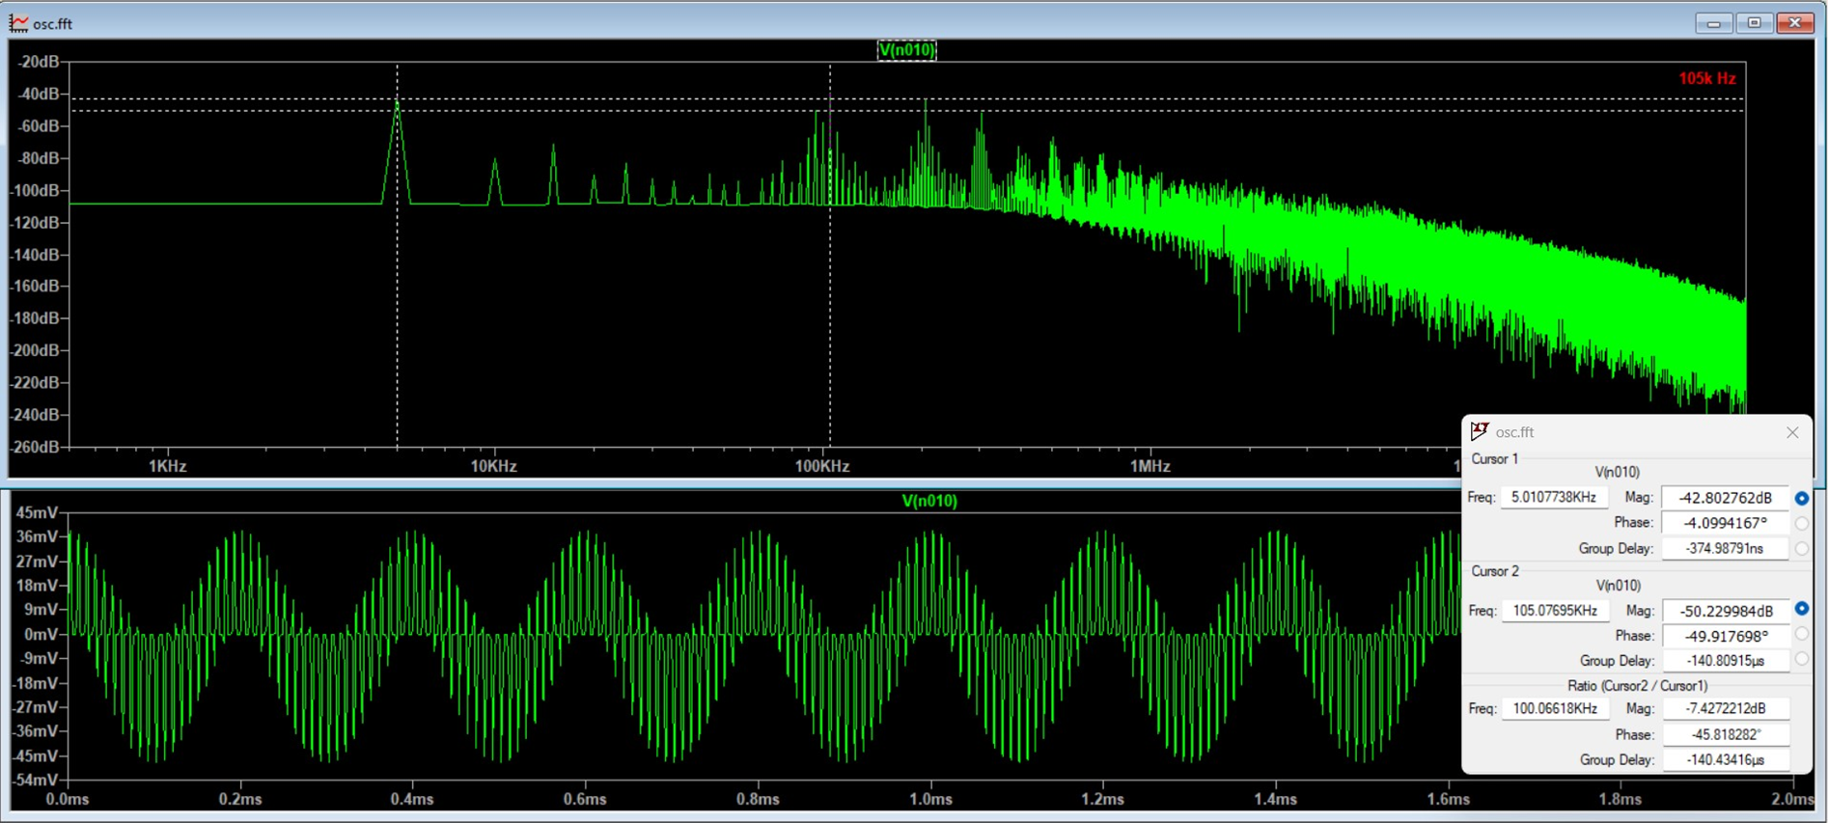
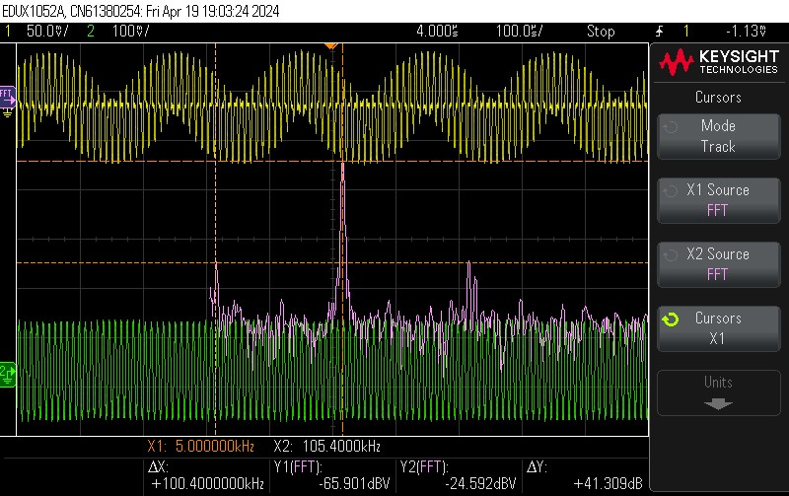
Transient And FFT Plots for f_{IN} = 102kHz
Transient And FFT Plots for f_{IN} = 105kHz

Slide 20
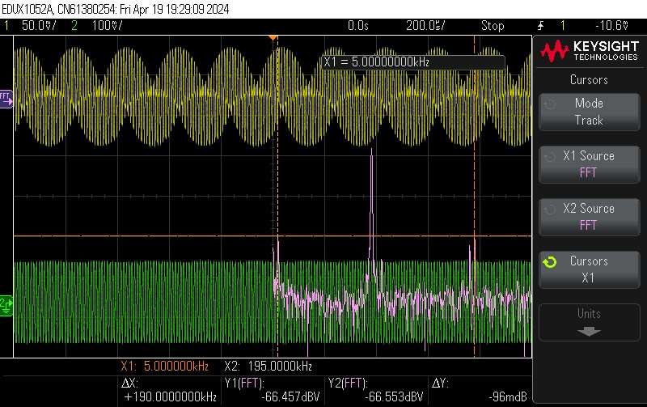
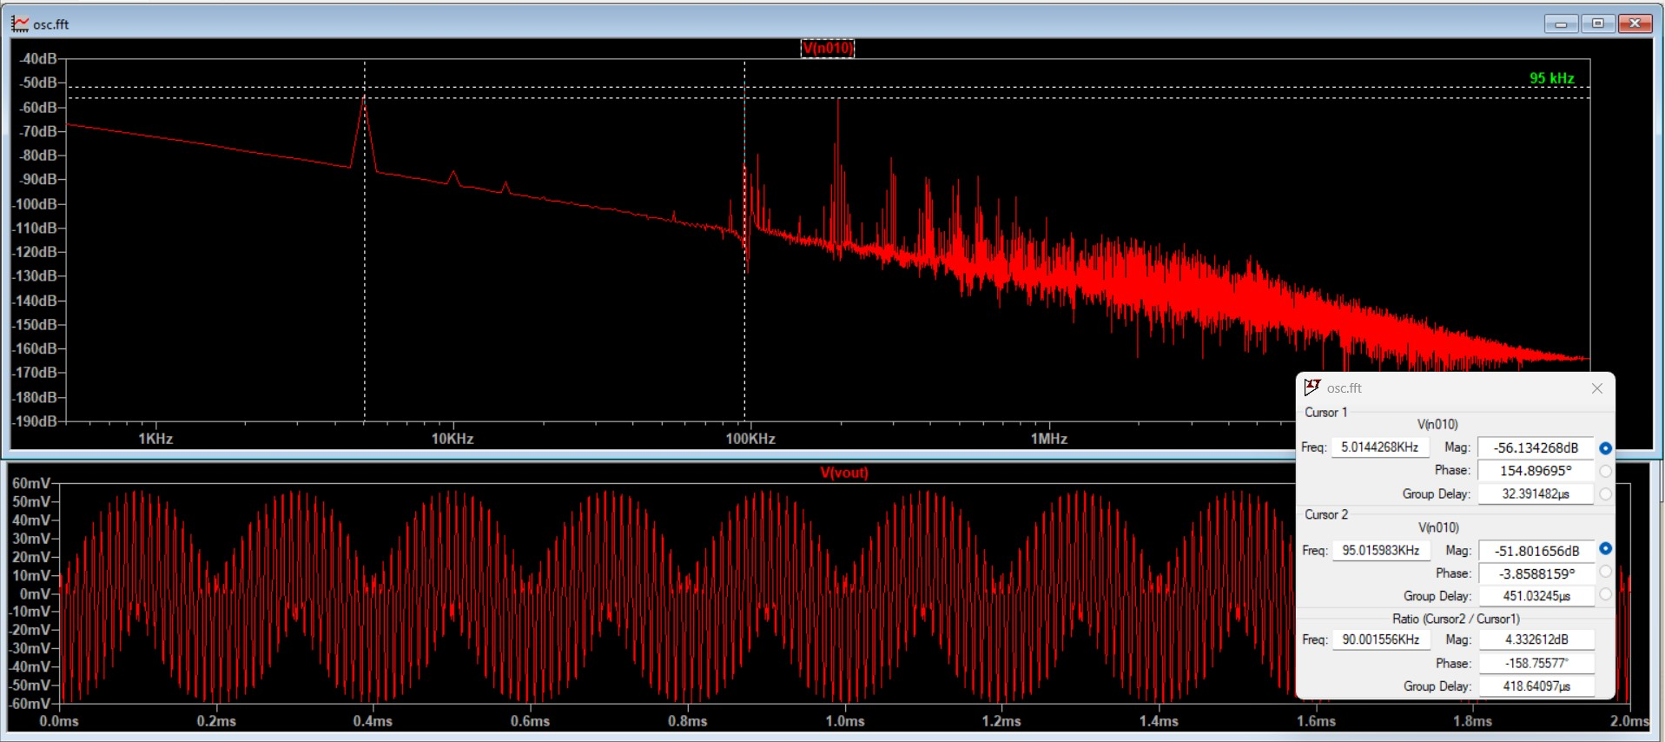
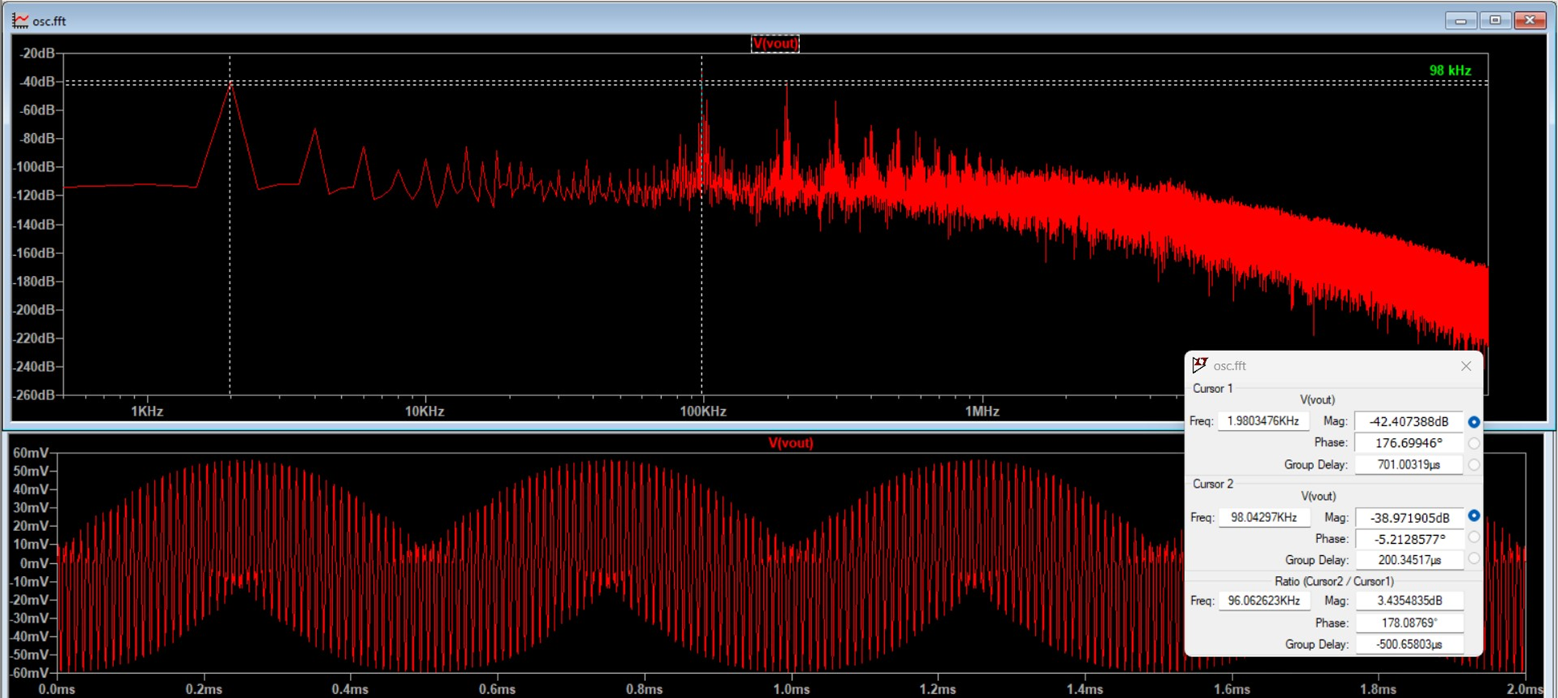
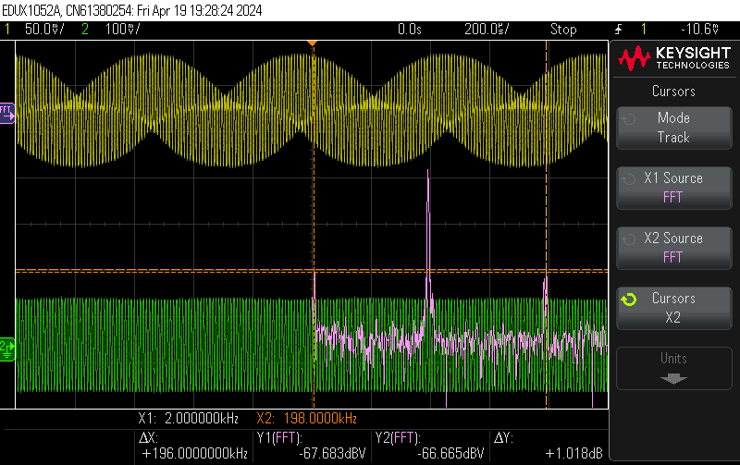
Cos wave
Transient And FFT Plots for f_{IN} = 95kHz
Transient And FFT Plots for f_{IN} = 98kHz

Slide 21
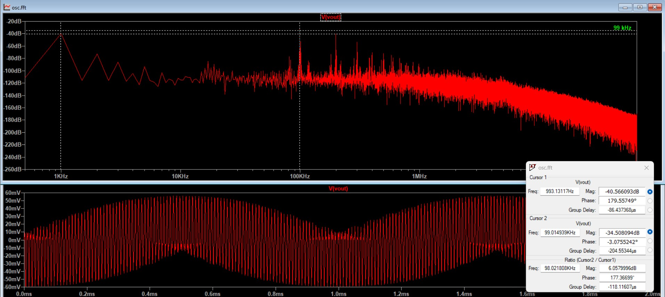
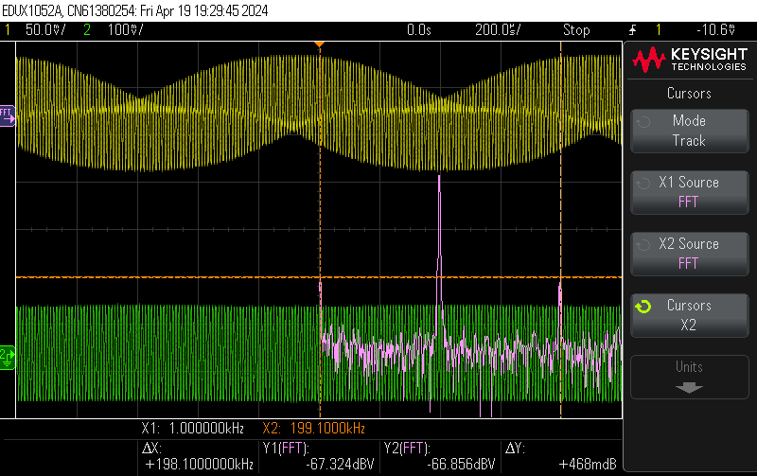
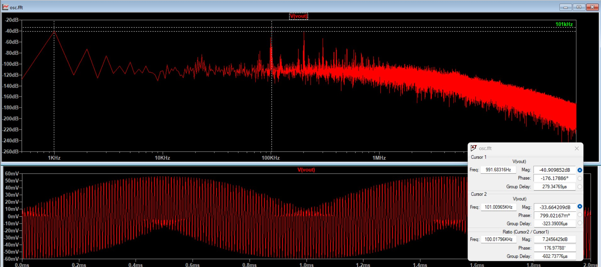
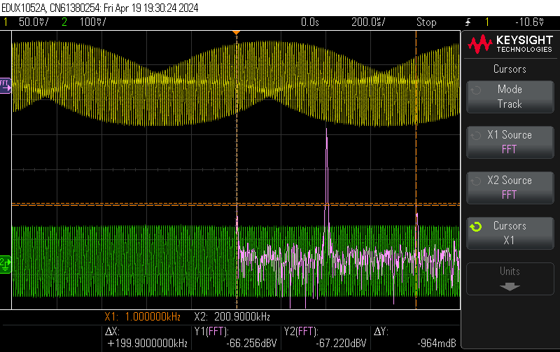
Transient And FFT Plots for f_{IN} = 99kHz
Transient And FFT Plots for f_{IN} = 101kHz

Slide 22
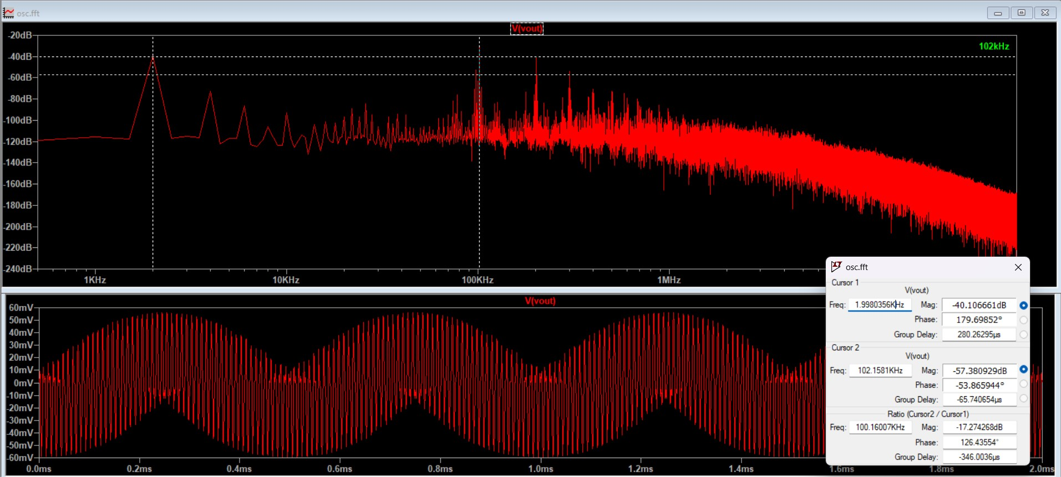
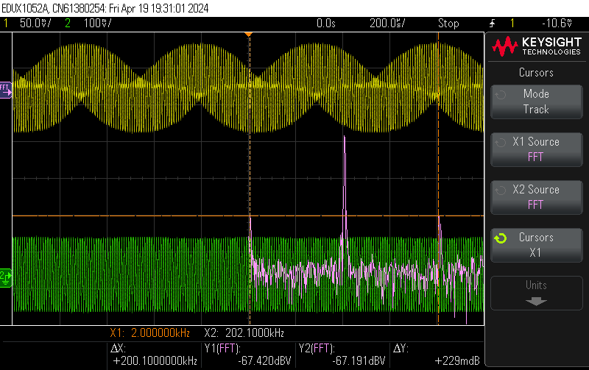
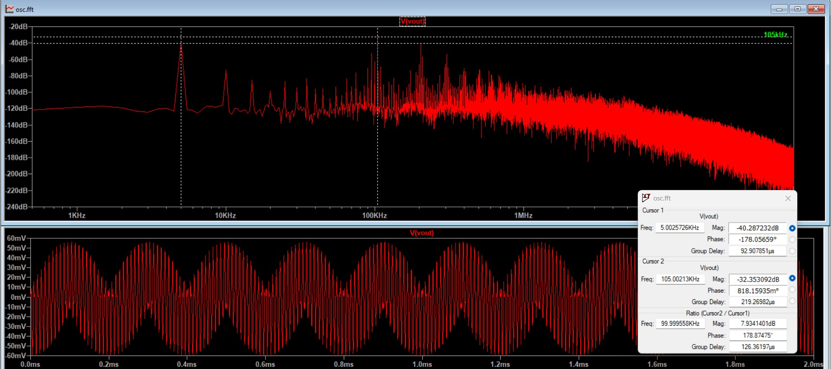
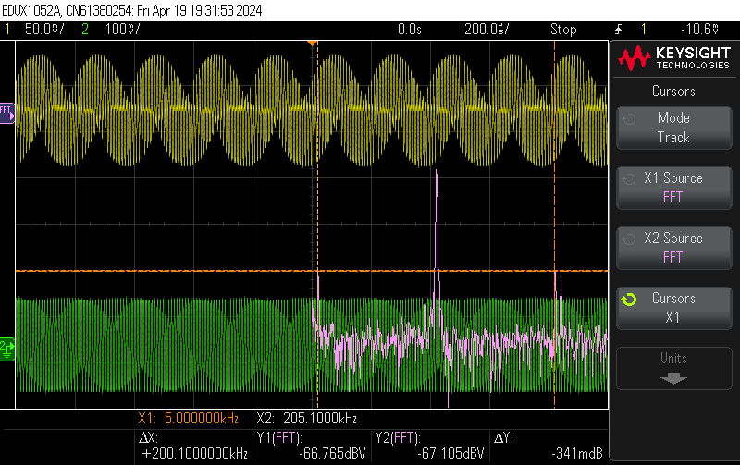
Transient And FFT Plots for f_{IN} = 102kHz
Transient And FFT Plots for f_{IN} = 105kHz

Slide 23
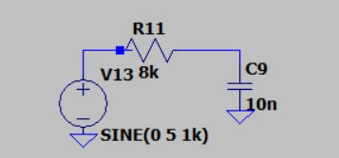
LOW PASS FILTER (2KHz)
CIRCUIT DIAGRAM

Slide 24

WORKING OF A LOW PASS CIRCUIT
The low pass filter allows the signals with the frequencies below the resonant frequency to pass through but attenuated the frequencies with frequencies higher than the resonant frequency
The transfer characteristics of the low pass filter is
At high frequencies the output will be very less according to the formula.
At low frequencies the output will be almost same as the input.

Slide 25
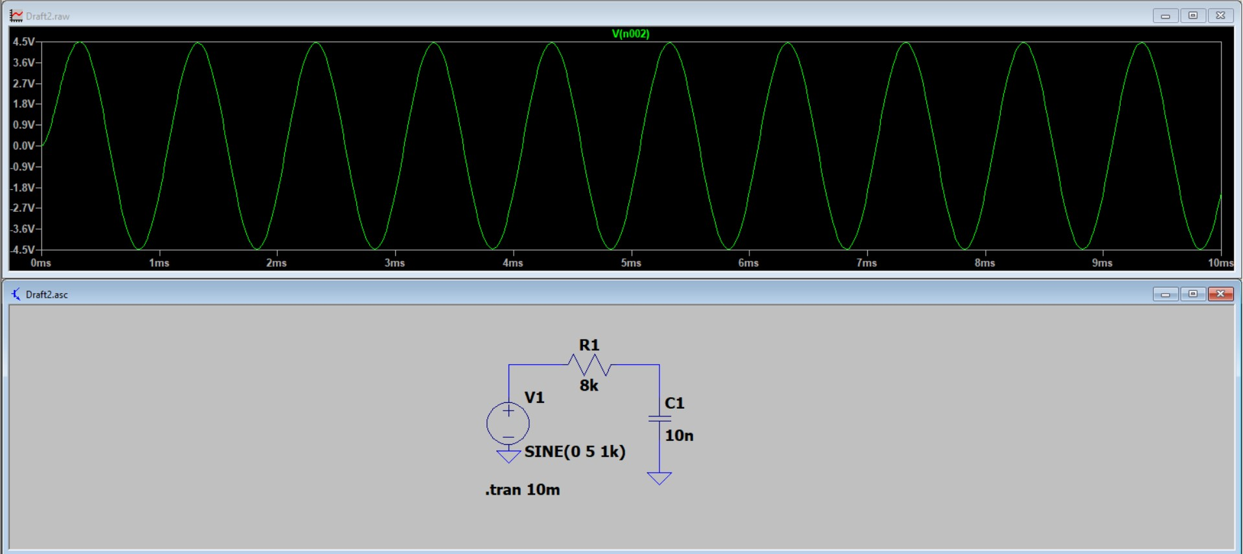
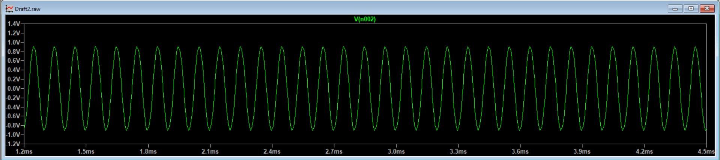
Transient Responses
For 1kHz signal
For 10kHz signal

Slide 26
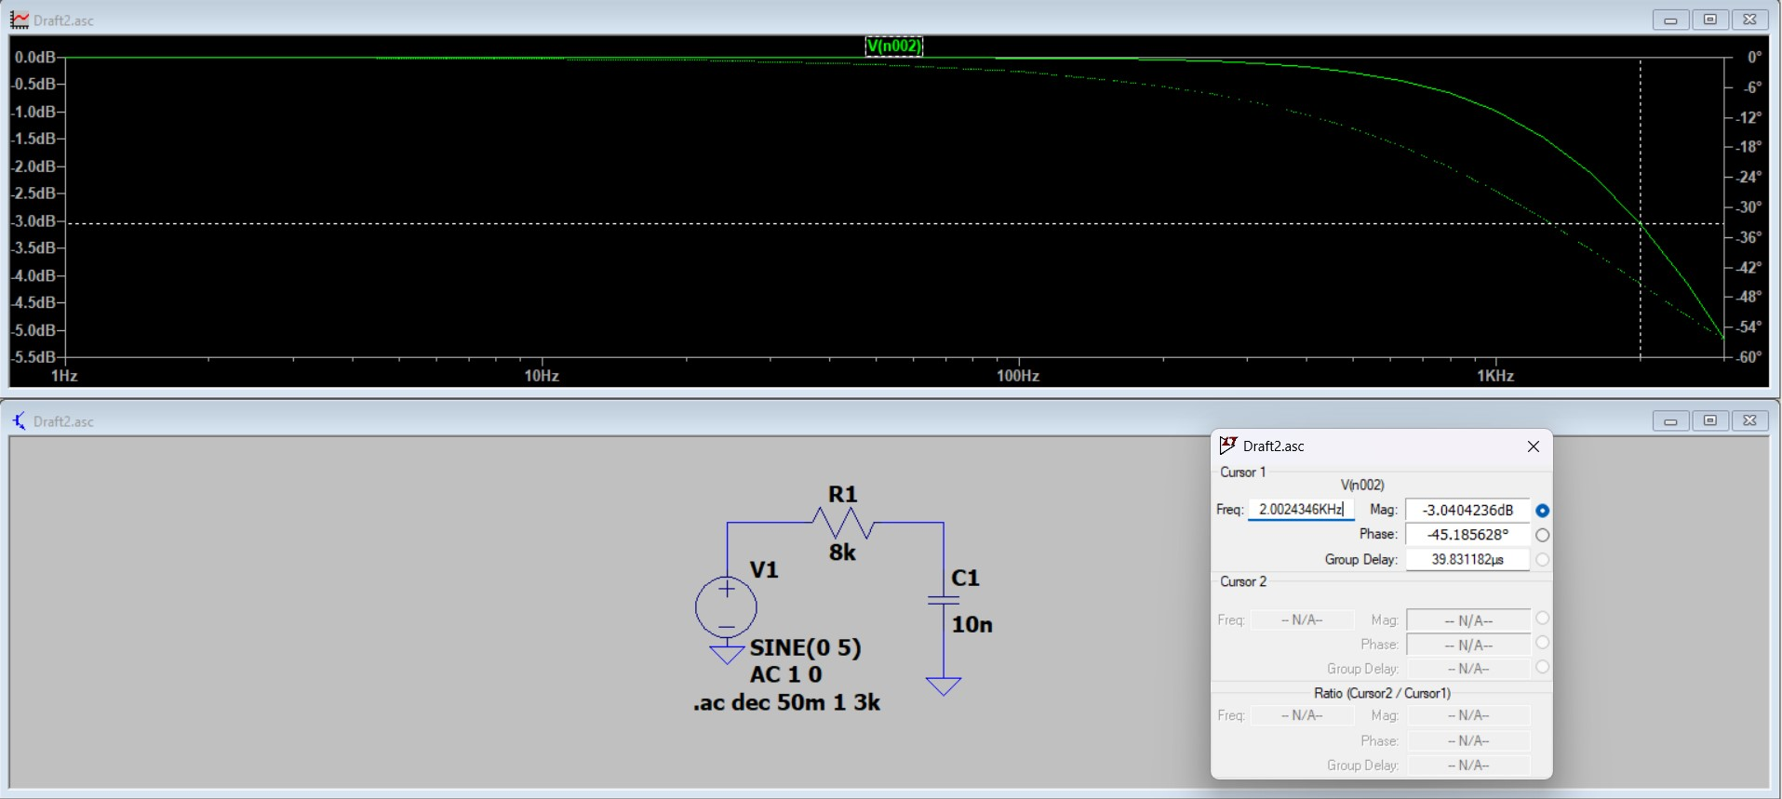
Frequency Response

Slide 27
Calculation for RC Filter
Values taken : R = 8.2k ohm
C = 10 nF
Cutoff Frequency = 1 / 2*pi*R*C
= 1/6.28 x 8.2k x 10n
= 1941.8983 Hz
= 2k Hz(approx.)
V_{out} / V_{in} = (1/sC )/ R + (1/sC )
= 1/ 1 + sCR
|V_{out}/V_{in}|=1/root(1+(RCω)²)
-3 dB Cut-off Frequency
|V_{out}/V_{in}| = 1/ √2 |1/√(1+(RCω)^2)| = 1/√2
1/(1+(RCω)^2) = ½
(R.C.w)^2 = 1
w = 1/RC
f = 1/2piRC

Slide 28
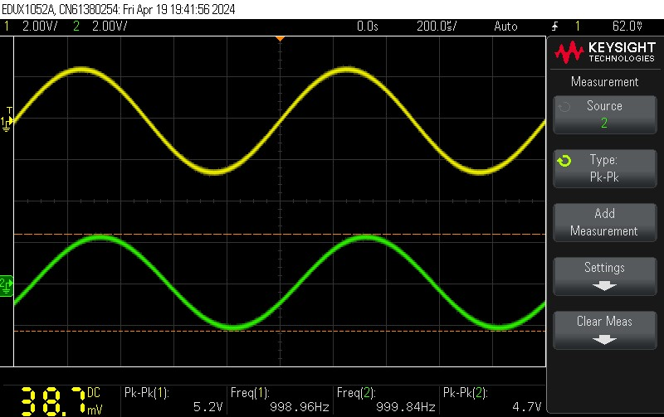
Low Pass Filter Transient Plot for frequency of 1kHz

Slide 29
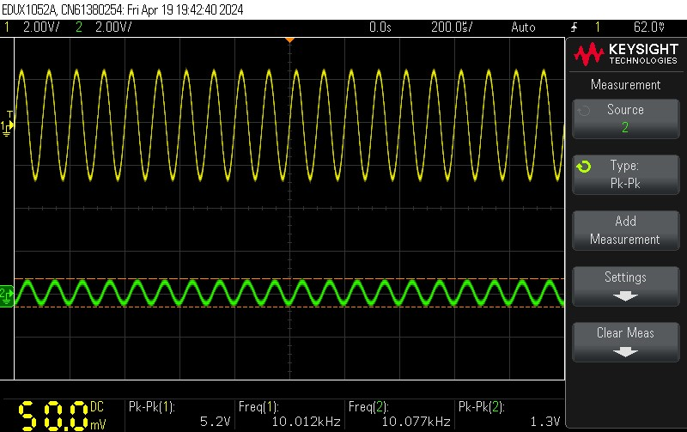
Low Pass Filter Transient Plot for frequency of 10kHz

Slide 30
THANK YOU

